Slide 1
IMAGE SHAPE PREDICTION AND DETECTION

Slide 2
PRESENTED BY
A.R BHARADWAJ(197R1A05C5)
A.ABHAYA VIKAS(197R1A05C3)
UNDER GUIDENCE OF
J NARASIMHA RAO(Asst. Prof.)

Slide 3
ABSTRACT
Human Vision is an incredible process of identifying different objects. we can differentiate the objects with the help of vision Object Dimensions Measurement program is used to measure the dimensions of objects. Which helps in automation, capturing and identification of particular instance of the object.
These days, real-time object detection and dimensioning of objects is an important issue from many areas of industry. This is a vital topic of computer vision problems. There is a need for enhanced technique for detecting objects and computing their measurements in real time from pictures.
For this, we will take the reference as the a4 sheet. After that the dimensions of the object are measured. At real time two different objects or states could be help full in differentiating the different objects in actual. We'll refer to this part of the architecture as the "backbone" network, which is usually pre-trained as an image classifier to more cheaply learn how to extract features from an image. This is a result of the fact that data for image classification is easier (and thus cheaper) to label as it only requires a single label as opposed to defining bounding box annotations for each image. Thus, we can train on a very large labeled dataset (such as ImageNet) in order to learn good feature representations.

Slide 4
EXISTING SYSTEM
The current system uses a webcam for capturing images and it will not save the output. The data saved can't be accurate. And the dimensions are not measured in proper manner. Without proper quantifying the object it would be very tough in real time situations to judge the object.
The current system also not sure in identification of the object shape. It is mandatory to guess the shape of the object since, without shape analysis we can't identify the object undeniably.
The real System which exists doesn't analyze the accuracy and precision of the object and the resolution is not properly used which leads to dumbfounding of the similar objects The real existing systems need to be improved among dimension identification properly.

Slide 5
DISADVANAGES
Tough at dimensions scheming
No object accurate evaluation
Identification of object is not possible
Differentiating the object is tough task.
Not Adoptable
High resolution is not possible
Data saving doesn't exist
Shape predictions are not possible

Slide 6
PROPOSED SYSTEM
We propose a better system by improving the existing systems deformity. By adding some notations to the subsist. We plan for better and advanced identification System which can detect the accurate dimension and shape of the object when its uploaded which helps in automatically recognition of the object
We take help of NUMPY for calculating the dimensions of the proposed object which also has functions for working in domain of linear algebra, Fourier transform, and Matrice. NumPy arrays are stored at one continuous place in memory unlike lists, so processes can access and manipulate them very efficiently. NumPy arrays have an attribute called shape that returns a tuple with each index having the number of corresponding elements. Which make our project so consistent and accurate. Calculating object dimensions helps in detection of perfect shape of the object.
We also analyze the vision by upgrading the OPENCV which helps computer vision and machine learning software library. OpenCV was built to provide a common infrastructure for computer vision applications and to accelerate the use of machine perception in our commercial product.

Slide 7
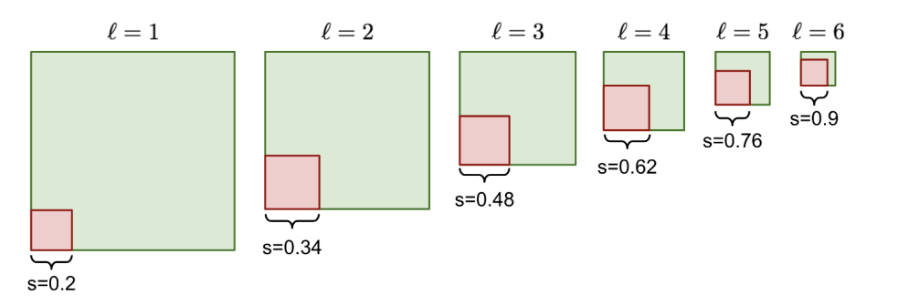
With the help of these we can calculate the undisclosed objects and analyze the shape, size and dimensions which helps in predicting the object without human vision. And also helps in auto analysis.

Slide 8
ADVANTAGES
Dimensions Scheming
Object detection and accurate measurement of the object image uploaded
Identifying the object uploaded
Differentiating the unknown objects
High resolution of identified object
Data saving
Shape identification and separation of surface
Helps in industrialization and automation

Slide 9
HARDWARE AND SOFTWARE REQUIREMENTS
64/32-bit operating system
Minimum of 4GB RAM
4GB Hard Disk
Camera with 1080 pixel
i3 processor
PyCharm IDE
NumPy, OpenCV
Python 3, Spider and Anaconda

Slide 10
NOVALITY
Self-activin size detection of un known body
Dimensions prediction
Accurate assessment of dimensions of the object
Shape predictions
Predicting the type of the object

Slide 11
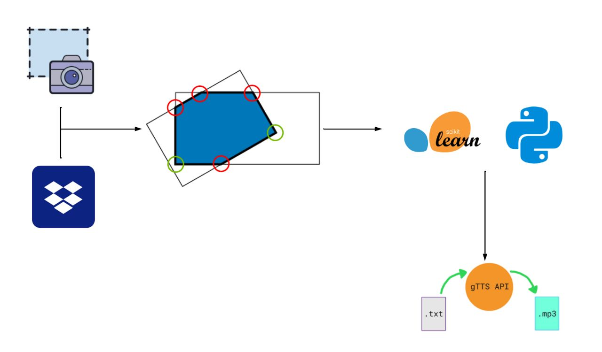
ARCHITECTURE

Slide 12
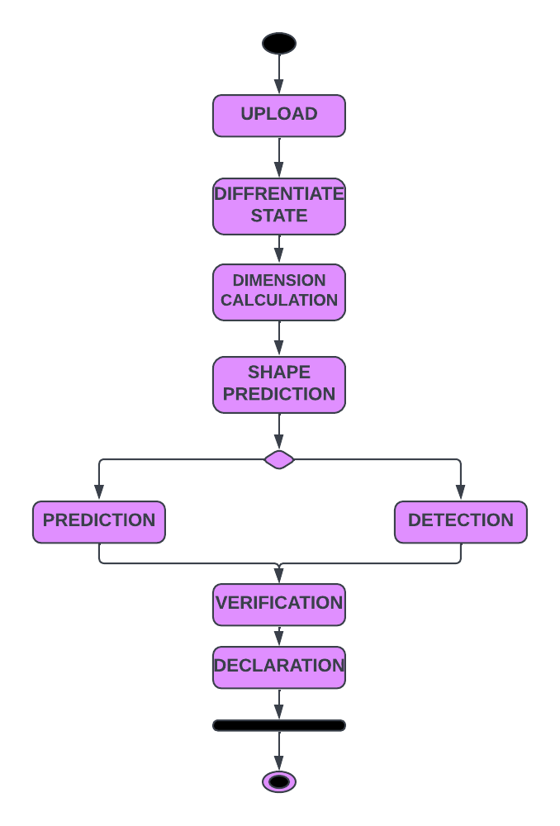
ACTIVITY DIAGRAM

Slide 13
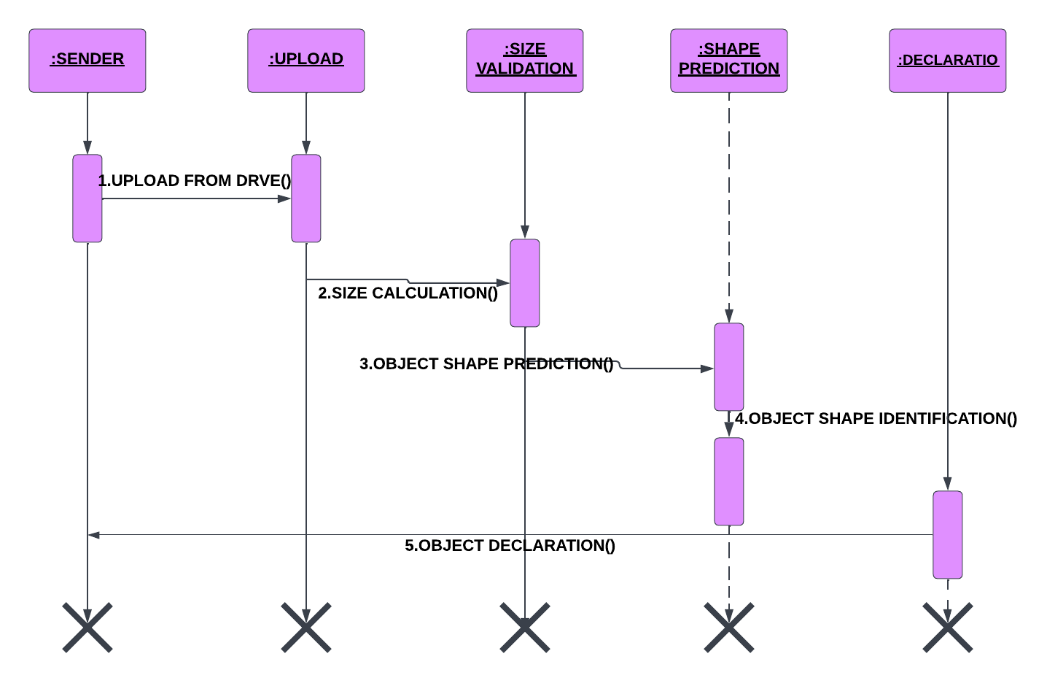
SEQUENCE DIAGRAM

Slide 14
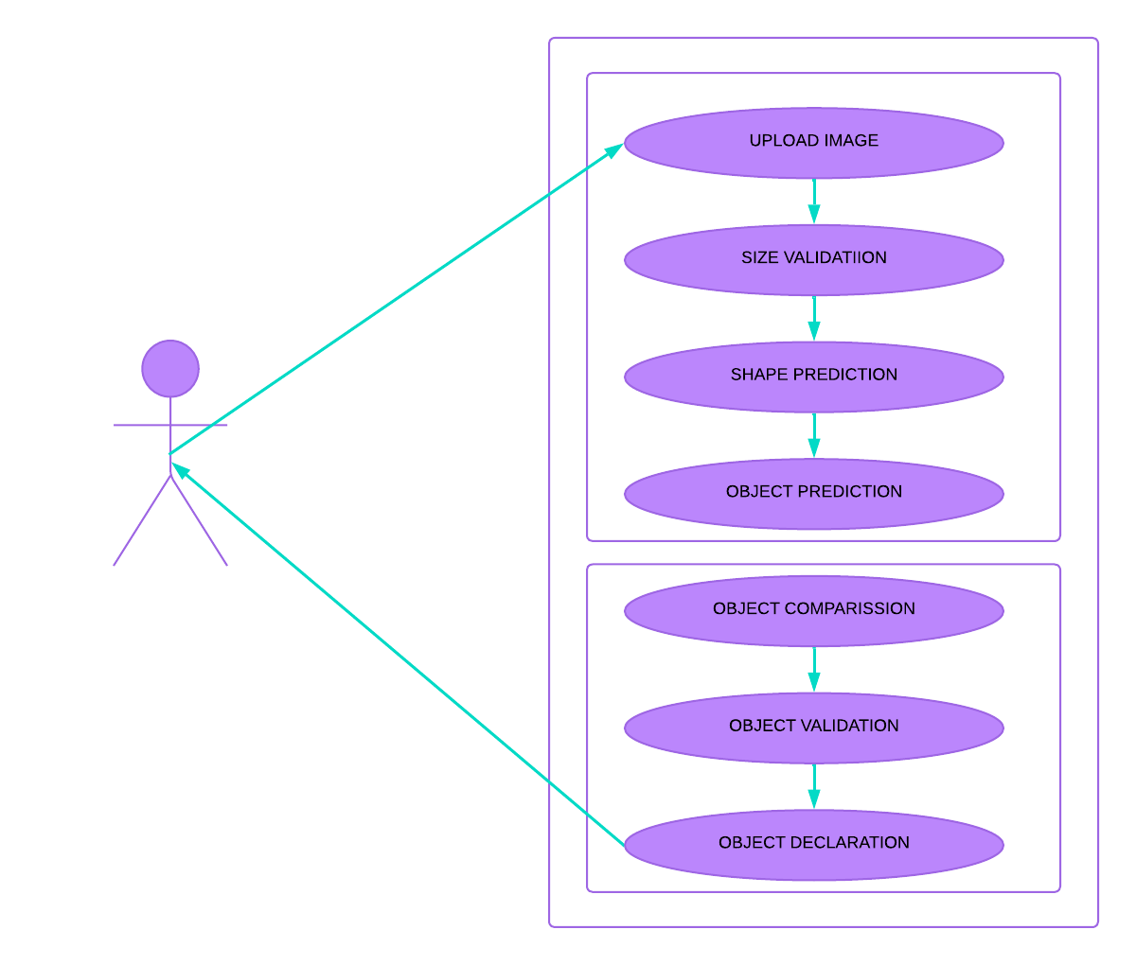
USE CASE
DIAGRAM

Slide 15


Slide 16
IMAGE SELECTION
Above image shows the way image uploading and selection by the user for
Finding its dimension, and shape, by selecting the image from the file saved in the
user's machine or dropbox. So the system can identify its information.

Slide 17
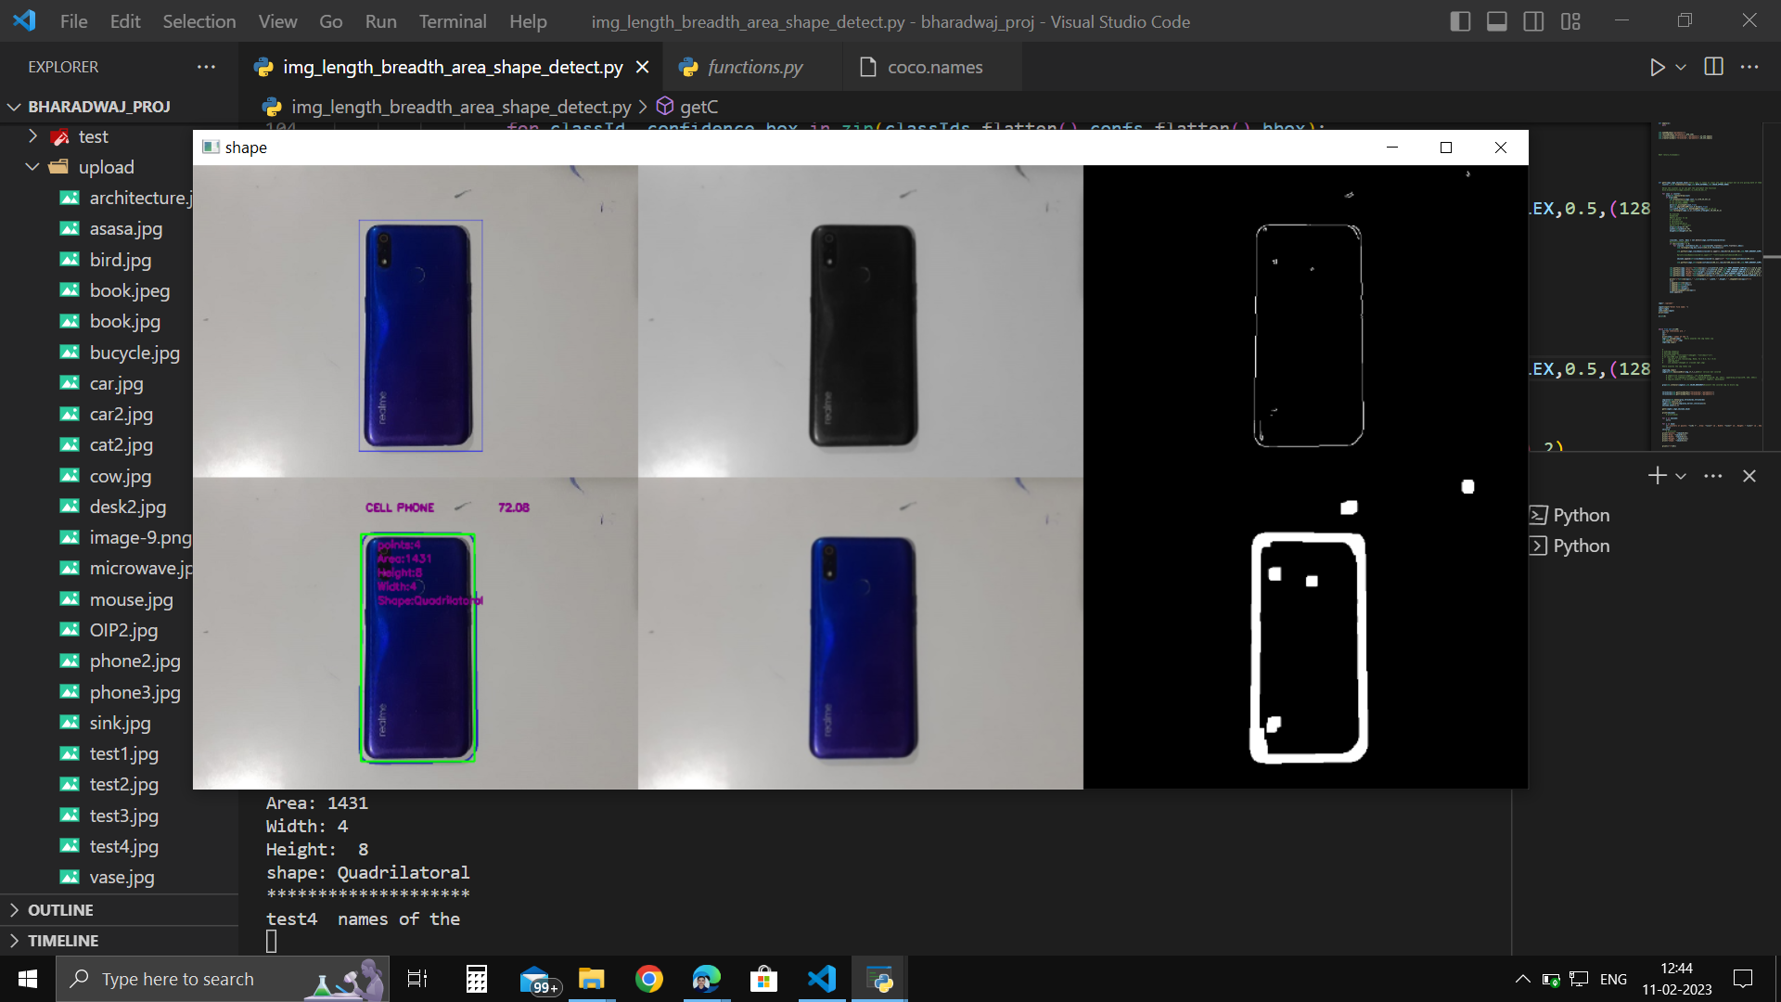

Slide 18
IMAGE DIFFERENTIATION
Above image identifies the surfaces present in the image uploaded by the user and reads the image for dimension detection and identifying the corners and edges of the image which help to find the shape, and area of the image taken by the user and removes the unwanted surfaces in the uploaded image.

Slide 19
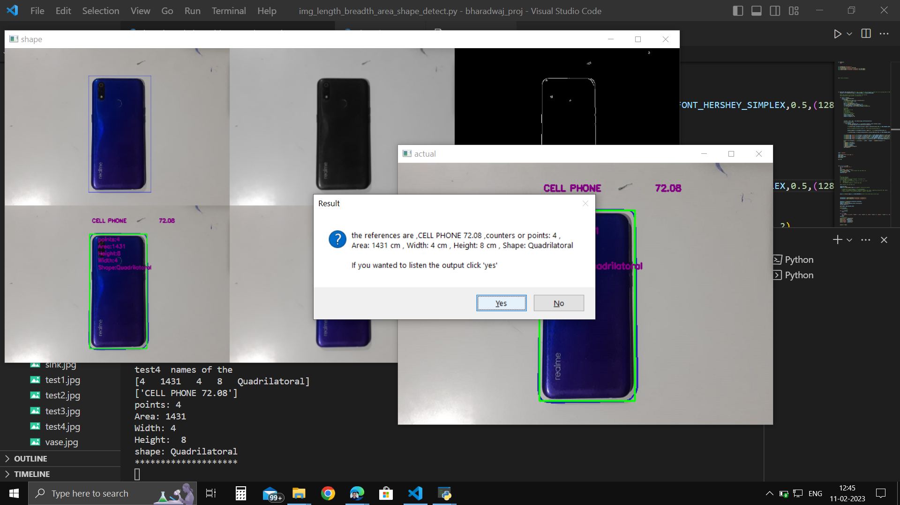

Slide 20
IMAGE ANALYSIS
Above image detects the corners of the taken object and makes its outline compute its dimension and predicts the shape of the object which we compare in our data set to identify the accurate object by analyzing both the data set and image processing

Slide 21
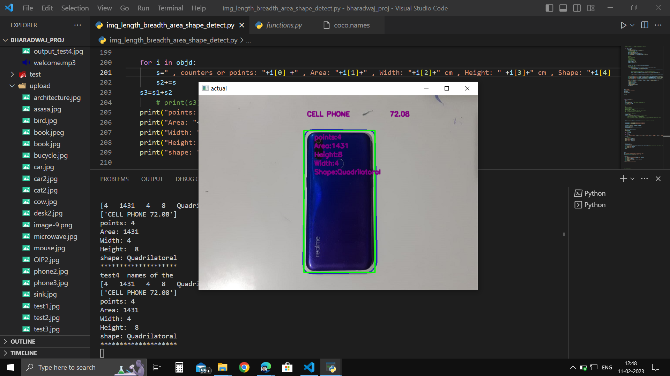

Slide 22
OUTPUT
This screenshot shows the dimensions, shape, area, and corners present in the taken object which gives complete information about the image uploaded by the user

Slide 23
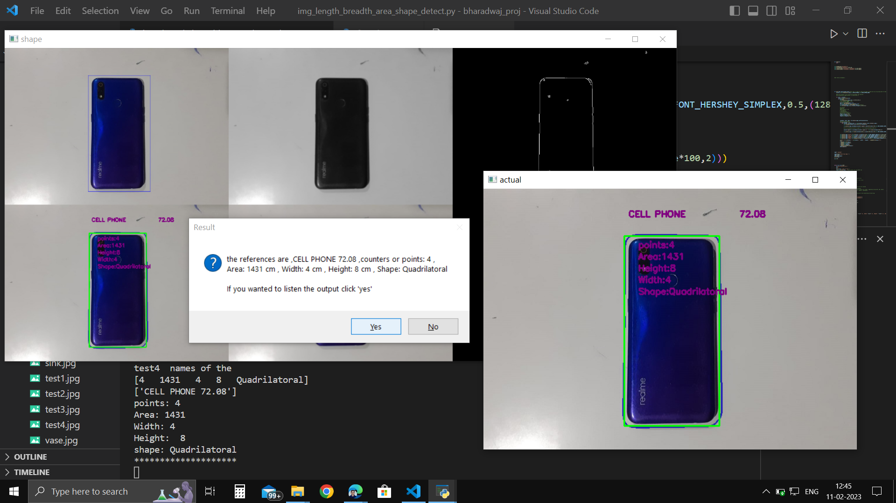

Slide 24
OUTPUT FORMAT
This project gives the scope of formatting the output which helps the user to identify the object and its characteristics in the audio and text format based on the user's desire.

Slide 25
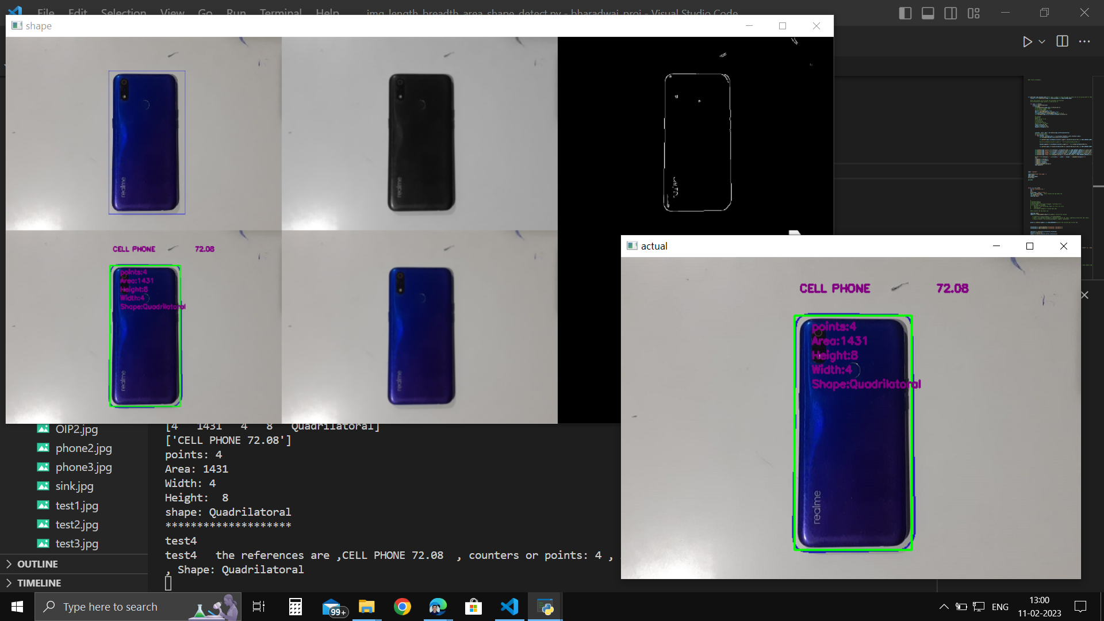

Slide 26
CONCLUSION
This project focus on the size detection of unspecified object, predicts its dimensions and evaluate their schema accurately. This also helps in shape identification of unknown objects which might hazardous or virulent objects. The accurate size evolution helps in finding the perfect shape and helps in its algebra which helps in predicting the object

